Slide 1
SOMIA
dream without end
english subconscious vocabulary learning app
- Powerify -
HA 30

Slide 2
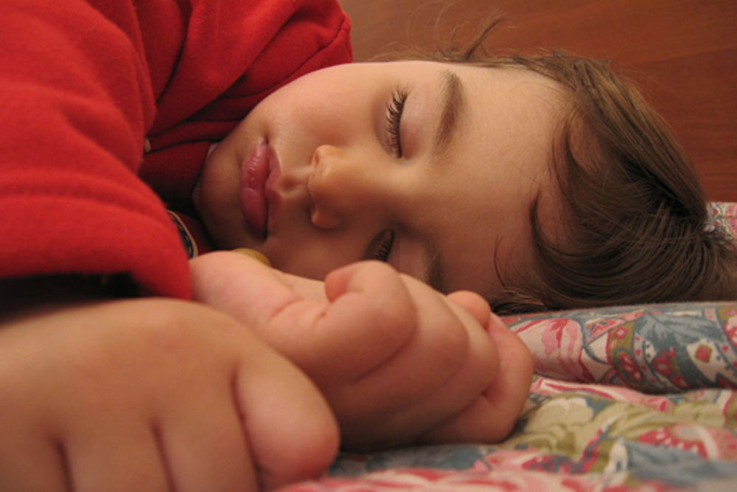
SUBCONSCIOUS LEARNING
As a child, we learn things subconsciously
http://www.nature.com/neuro/journal/v16/n4/full/nn.3343.html

Slide 3
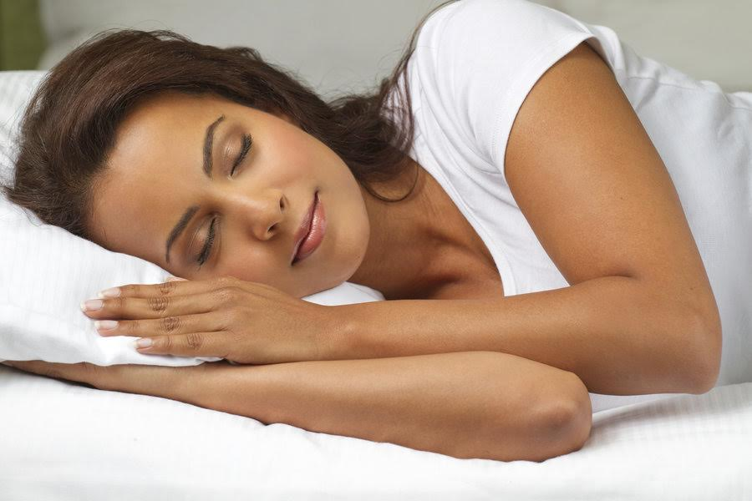
SUBCONSCIOUS LEARNING
A good night's sleep triggers changes in the brain that help to improve memory
https://www.sciencedaily.com/releases/2005/06/050629070337.htm

Slide 4
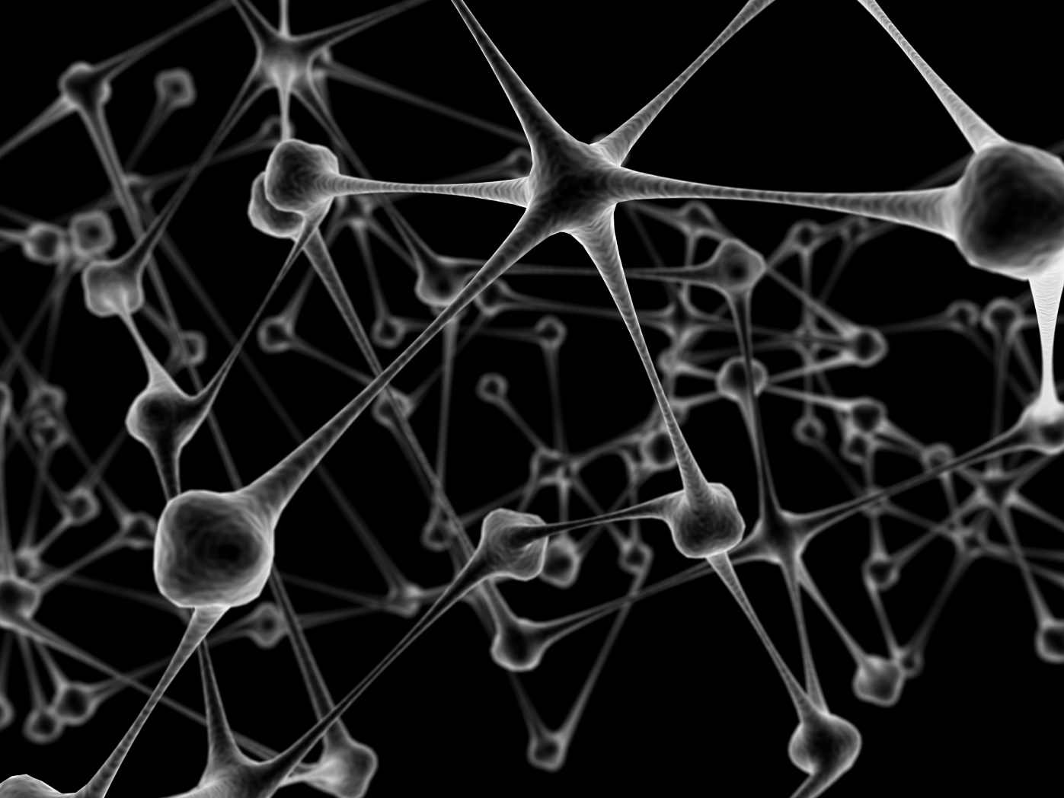
HOW?
Brain solidify information during sleep time

Slide 5
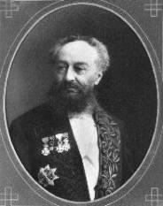
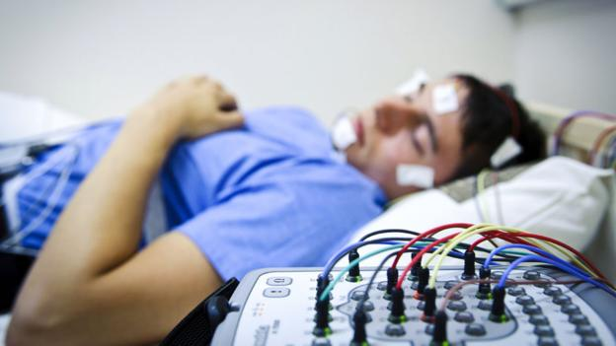
How subconscious learning?
Marquis d’Hervey de Saint-Denys found that he could bring back certain memories with the relevant smells, tastes or sounds.
Only play words already heard
Run for the first 2-3 hours of sleep
Give a quiz to test your recall while awake
http://www.forbes.com/sites/daviddisalvo/2014/07/28/how-to-really-learn-a-foreign-language-while-you-sleep/#7a78e95126c2

Slide 6
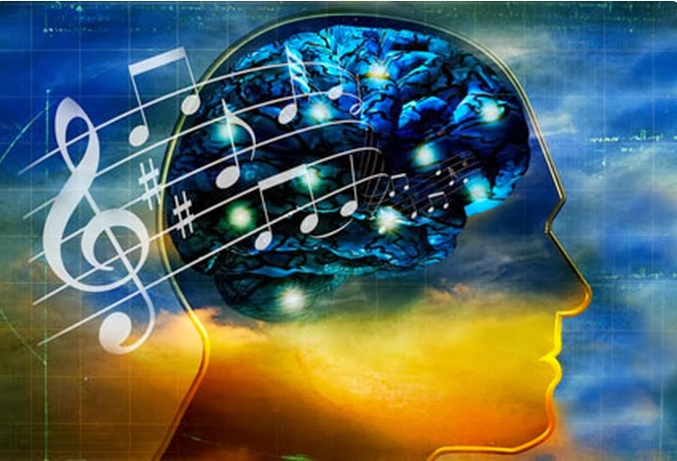
How subconscious learning?
Higher than 40 Hz, Gamma waves, Higher mental activity, including perception, problem solving, fear, and consciousness
13–39 Hz, Beta waves, Active, busy or anxious thinking and active concentration, arousal, cognition, and or paranoia
7–13 Hz, Alpha waves, Relaxation (while awake), pre-sleep and pre-wake drowsiness, REM sleep, Dreams
8–12 Hz, Mu waves Mu rhythm, Sensorimotor rhythm
4–7 Hz, Theta waves, Deep meditation/relaxation, NREM sleep
Lower than 4 Hz, Delta waves, Deep dreamless sleep, loss of body awareness
Music therapy

Slide 7
APPLICATION DESIGN
Sleep tracking – detect sleeping status
Music therapy – good for sleep music
Vocabulary audio – reinforce knowledge
Quiz – check progress

Slide 8
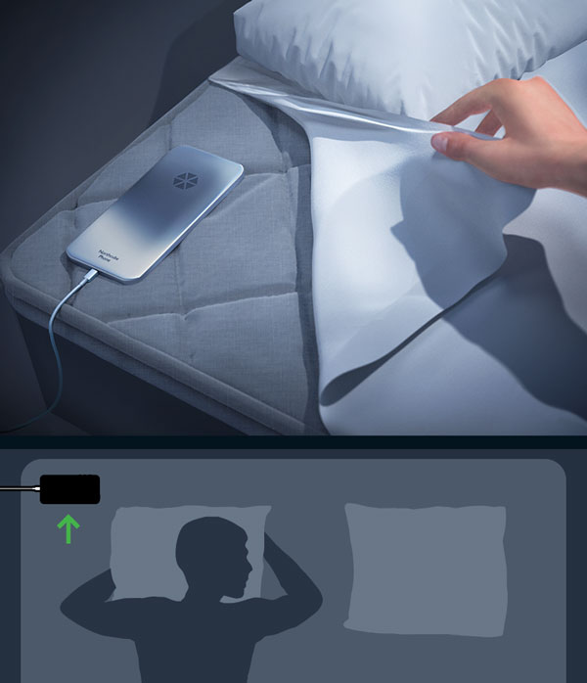
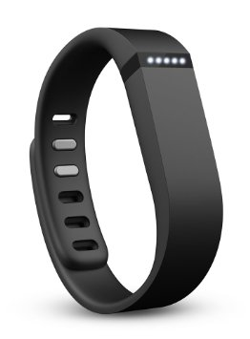
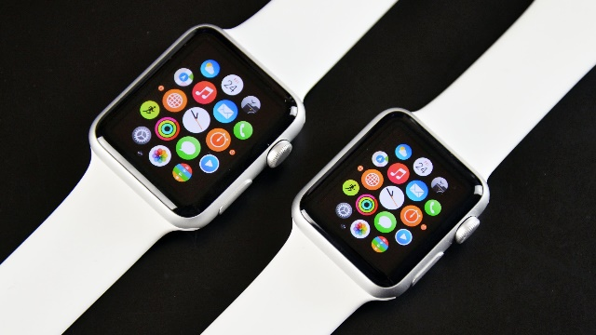
SLEEP TRACKING
Accelerometer/Muscles movement: Cost efficiency, low accuracy
EEG: most accuracy to date
Heart beat: Good accuracy
Breath/Snore sound: Low accuracy

Slide 9
ALGORITHM

Slide 10
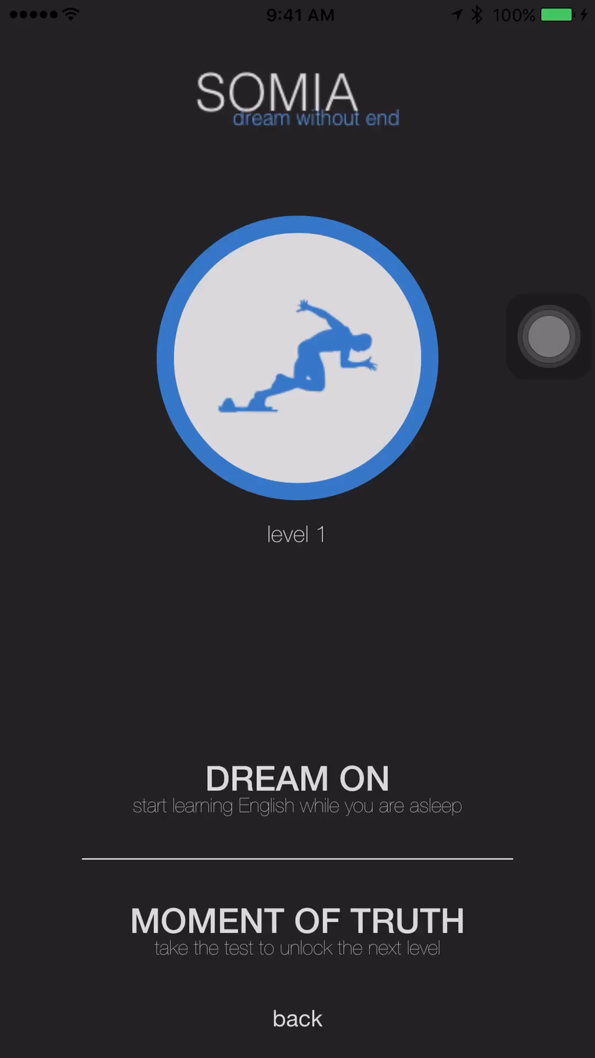

Slide 11
THANK YOU

